Slide 1

What is Marketing Mix Model?
01

Slide 2

Marketing Mix Modelling (MMM) is a privacy-friendly, highly resilient, data-driven statistical analysis that quantifies the incremental sales impact and ROI of marketing and
non-marketing activities
No requirement for individual or log level information, all analysis is aggregated
Works for all businesses and is remarkably customizable for individual circumstances and metrics Highly scalable and available, there is progress to make ever more open, transparent & democratized
Actionable and can used for forward facing scenarios There is innovation that makes it faster and more sensitive

Slide 3
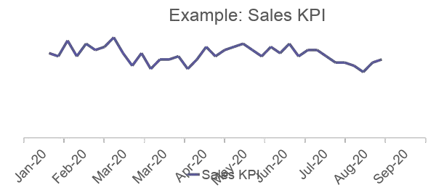
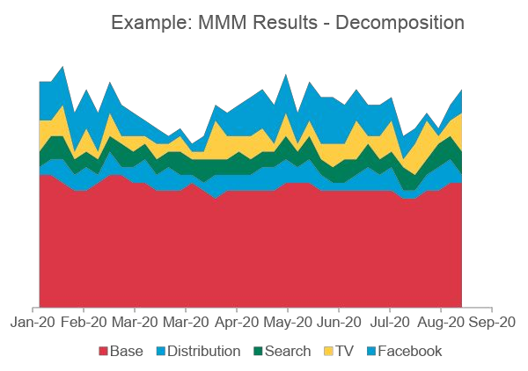
How are MMMs built?
MMMs identify and quantify drivers of a KPI, with the objective being to replicate historical business metrics by building an equation using available information on underlying drivers over time.
Mathematical formula is created with time series regression analysis
SOURCE | WEEK1 | WEEK2 | WEEK3 | WEEK4 | WEEK5 | WEEK6 | WEEK7 | …
TV GRPS | 200 | 150 | 150 | 200 | - | - | - | …
FACEBOOK IMPRESSIONS | 85,000 | 113,000 | 320,000 | 275,000 | 300,000 | 90,000 | 100,000 | …
SEARCH CLICKS | 3,475 | 1,225 | 1,995 | 2,850 | 3,525 | 975 | 1,115 | …
DISTRIBUTION % | 80 | 85 | 85 | 87 | 85 | 85 | 82 | …
WEATHER *C | 7 | 7 | 6.5 | 5 | 5 | 6 | 7
Key business metrics are compared to all relevant factors that influence them in the time period, historically, aggregated and over time.
If the effect is statistically significant, the model estimates the incremental impact for each influencing factor (“decomposition”). Base represents BAU, long term effects and non identified factors

Slide 4
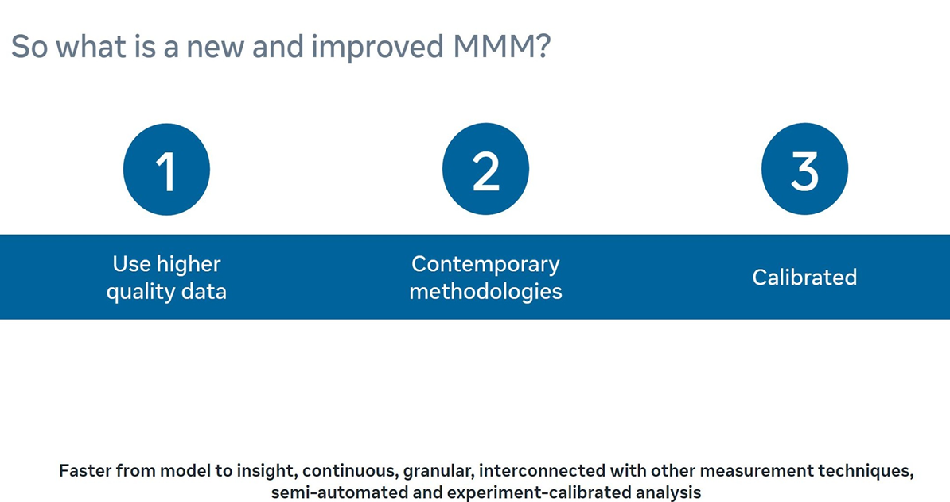

Slide 5
3 Key benefits
Contemporary methodologies based off latest research into MMM
1 2
3
Minimize Human bias
Align with ground-truth
Enable actionable decision-making
Benefit
Ridge Regression
Custom Adstocks
Automated hyperparameter selection
Prophet
Validation
Calibration
Experiments/ MTA
Geo
Custom Adstocks
Diminishing returns curves
Budget Allocator
9

Slide 6

Model methodology
03

Slide 7
Contemporary MMM
Machine Learning supported, granular, semi-automated and experiment-calibrated analysis, delivering insights faster and on continuous basis

Slide 8
What do we mean by contemporary methods?
“CLASSIC” MMM
Manual modeling Static multi-year models
Same ad stocks across all channels Multicollinearity and overfitting
Manual seasonality and dummy variables Statistical validation only
PROJECT ROBYN
Automated hyperparameter selection Dynamic & frequently update models
Custom Ad-Stocks
Ridge regression / regularization Modelled seasonality and trend (Prophet) Validated and calibrated with experiments

Slide 9
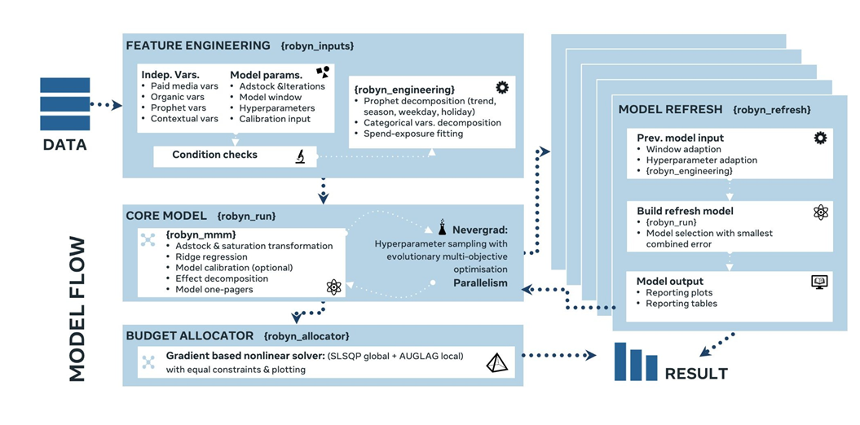
Regularized additive regression with automated evolutionary algorithm for hyperparameter optimization

Slide 10
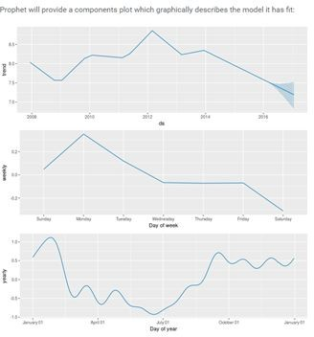
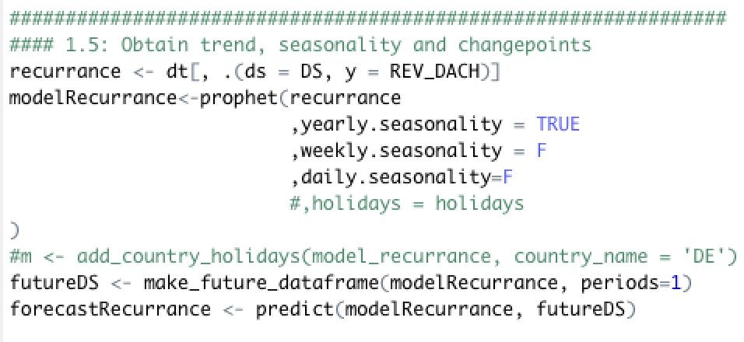
What is Facebook Prophet?
Open Source Machine Learning library for forecasting
CONSTRUCTING VARIABLES
What is Facebook Prophet:
Prophet is a Facebook open source ML library for forecasting time series data based on an additive model where non-linear trends are fit with yearly, weekly, and daily seasonality, plus holiday effects.
We use Prophet to decompose trend and seasonality directly from response as input variable for further modelling
What is Facebook Prophet:
Replaces manual dummy variables
Highly scalable approach
Improve fit and interpretability of the models

Slide 11
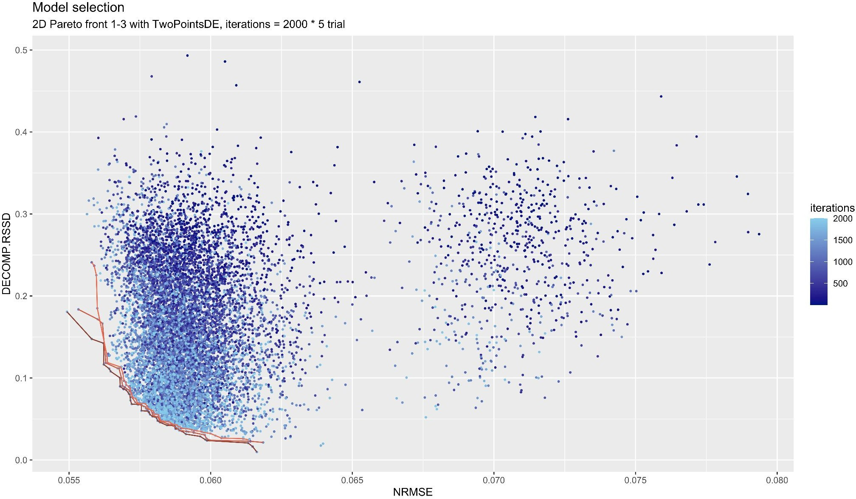
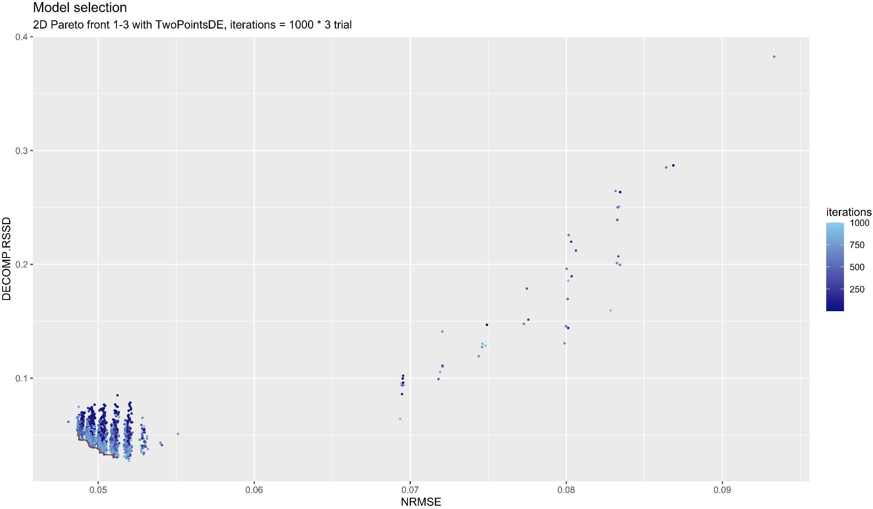
Optimisation example initial
model
Minimizing human bias
Classic MMM models rely heavily on the experience of the analyst when:
Selecting the right explanatory variables
Assigning the correct adstock and saturation curve shapes
Determining the trend and seasonality
OUR APPROACH
Optimisation example
refresh model
Automated multi-objective hyperparameter optimization with evolutionary algorithm: to efficiently sample all possible adstock and saturation curves combinations by minimizing model error, decomposition distance & calibration error
Ridge regression with cross-validation: a regularization technique that deals with intercorrelated explanatory variables. Prevents overfitting and allows more freedom of choice for variables
Prophet seasonality decomposition: a Facebook open source ML library for time series forecasting. We use Prophet to automatically decompose the trend and seasonality directly from response as input variable for further modelling.
●
●

Slide 12
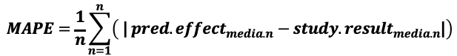
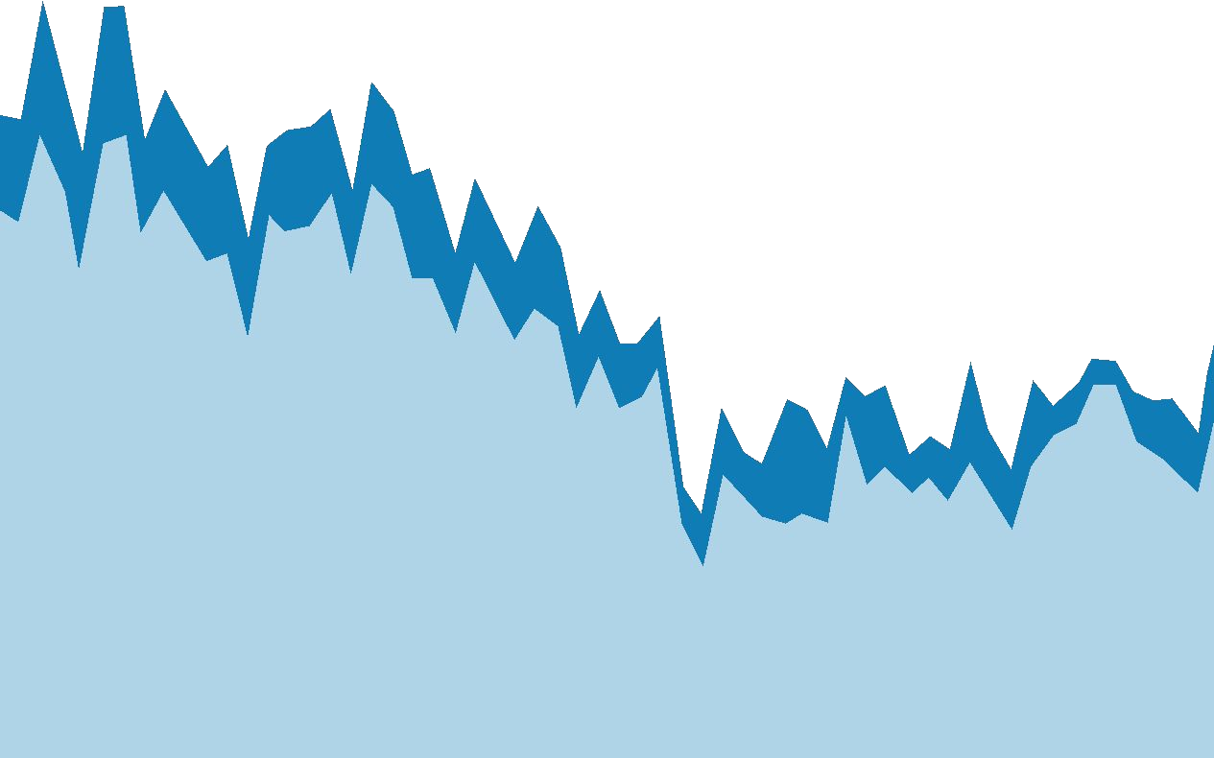
Aligning with Ground-Truth
Study 1
Test
Using experiments / randomised control trials (RCT) to determine the incremental effect of Marketing activities is already gold standard in the industry and often considered ground-truth. The need to introduce experimental result into MMM has been growing strongly over the decade.
Control
Study 2
Test
Control
OUR APPROACH
MAPE as calibration error : The percentage difference between experimental results and predicted sales for the certain channel is used as calibration error.
Additional objective function for hyperparameter optimisation: Robyn’s model calibration is done by minimizing the error between MMM predicted and ground-truth outcomes for the given channel and time period
Stronger weight for ground truth for Pareto optimality: Because experiments are considered ground truth, stronger weight for calibration MAPE is applied to ensure closer results to experiment
●
MMM Decomposition
●
Base + Other media
Media Channel n

Slide 13
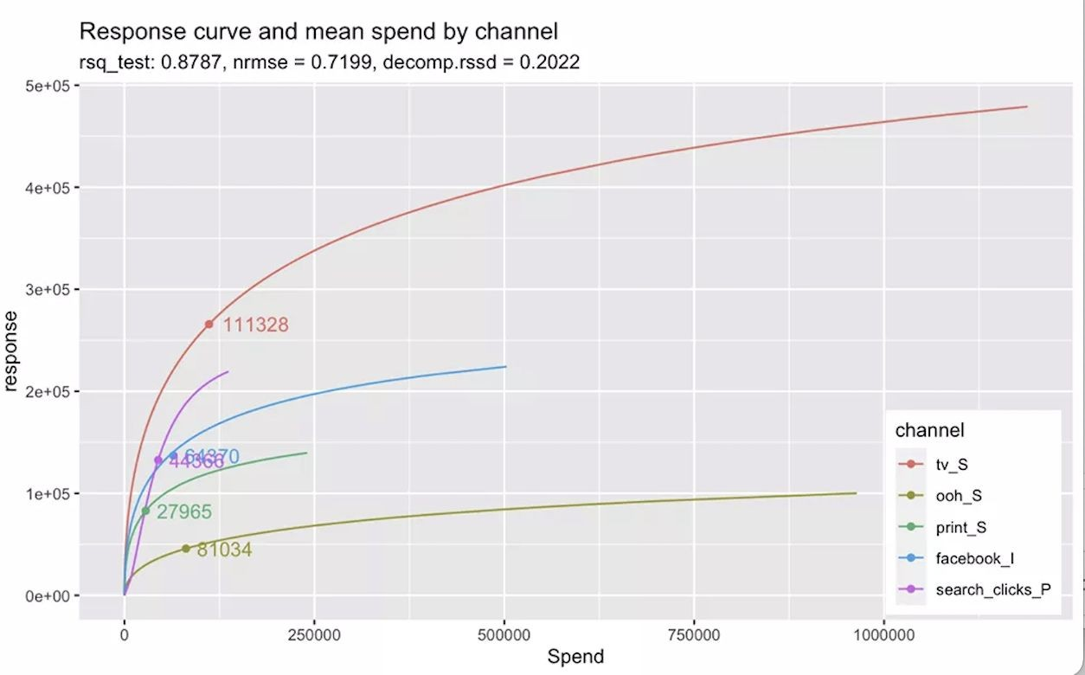
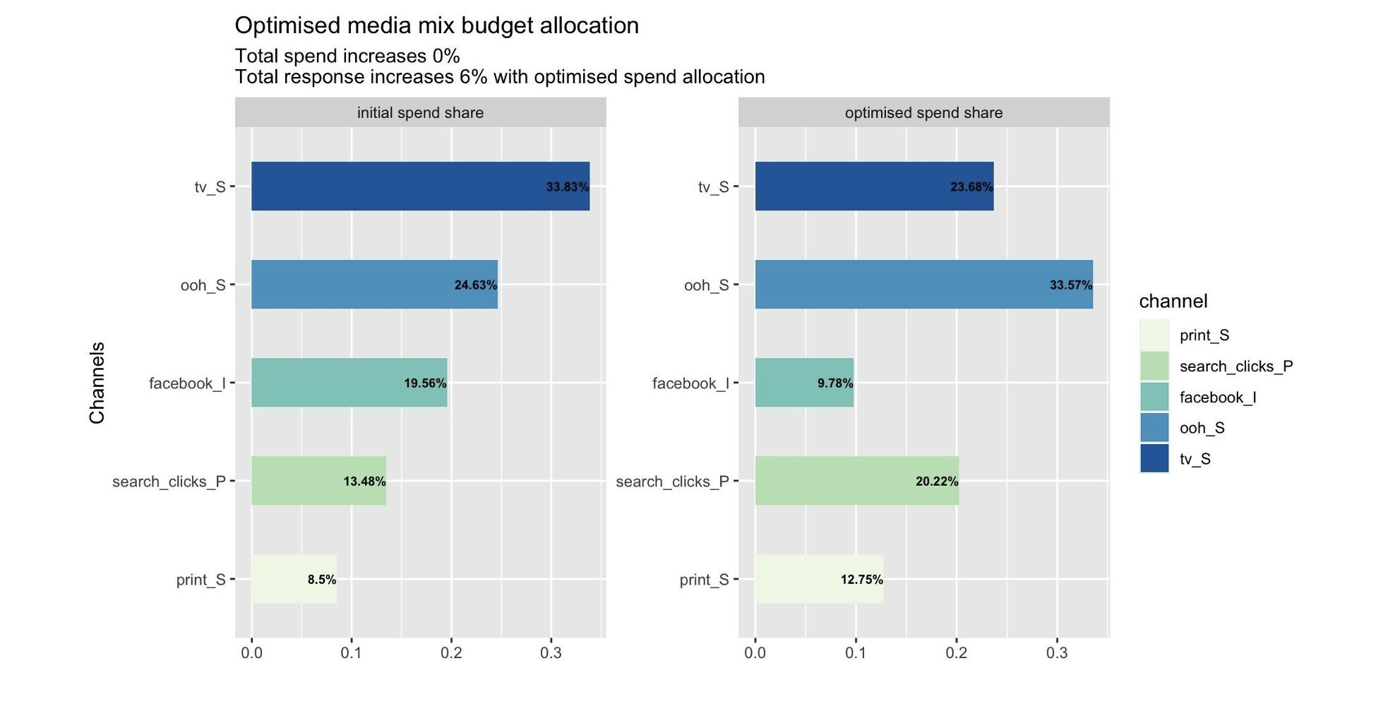
Enabling actionable decision making
Advanced MMM models enable actionable items for media budget allocation decision making:
Diminishing returns curves
Adstock curves
Budget allocator
OUR APPROACH
Budget allocator: MMA+AUGLAG non-linear solver that allows equal and unequal constraints and help you define optimal budget allocation for upcoming cycles.
Diminishing returns and adstock curves: the model prints out the curves for media for you to understand inflection points and where the sweet spot for investment is.
Continuous reporting - “always on” capability with frequent outputs and rolling analysis
17

Slide 14

What are Recency Splits?
Spitting variables by recency
CONSTRUCTING VARIABLES
Allows for recent / innovation to be accounted for within the model
Key for digital platforms where new features are released and scale quickly
Evidence that models that include recency variables have improved accuracy and outperform standard models
Traditional models-smoothed over time, recent events and changes lost
Recency split monthly showing recent events
Time

Slide 15
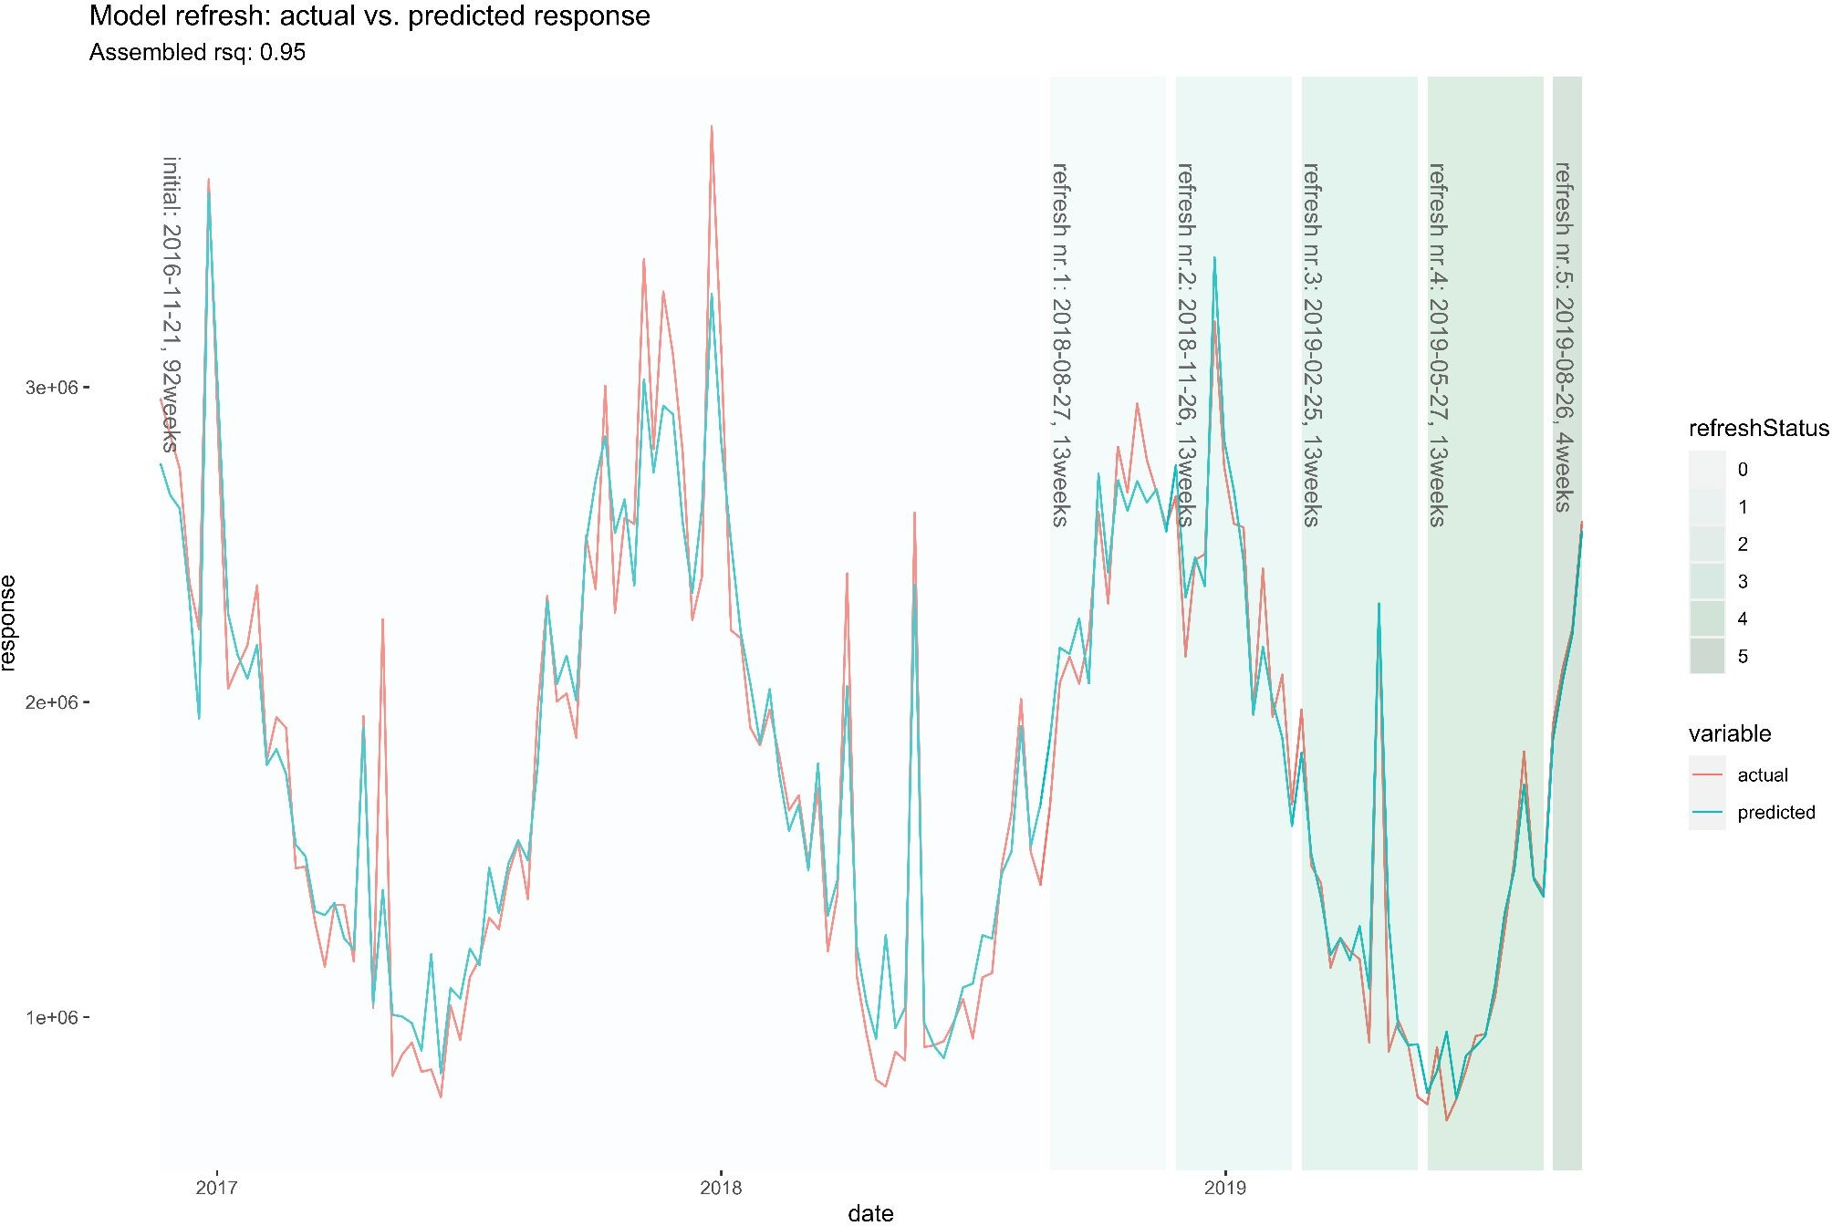
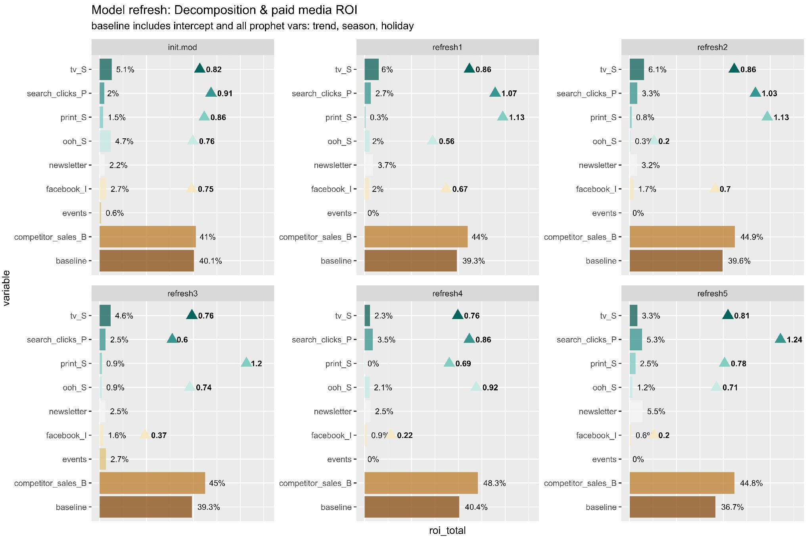
Model Refresh & Reporting Rolling Window
Key update addressing more actionability and continuous modelling via Rolling Window & Reporting features. This enables analysts to have models updated faster and in more persistent and perpetual model.
OUR APPROACH
Rolling window: set window_start and window_end to choose modelling period flexibly, enabling more agile and continuous model insights, while trend/season/holiday/weekday patterns are still decomposed from the entire dataset
Model refresh & reporting: refresh initial model with new data points and report every refresh with plot and csv output (plot example)

Slide 16
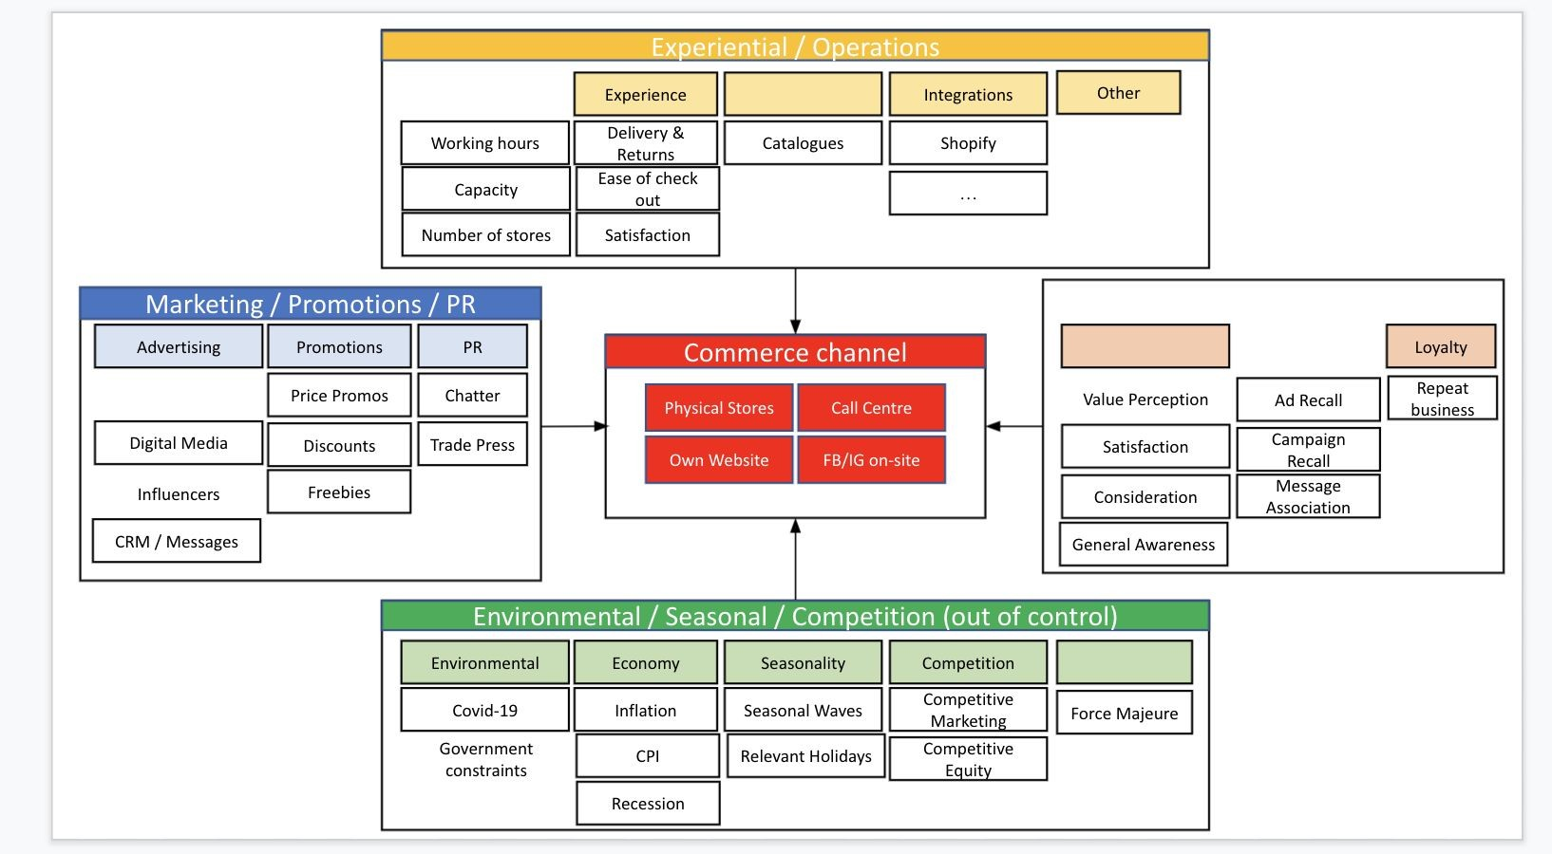
Organic Variables
One of the most required feature. Examples of typical organic variables:
Reach / Impressions on blog posts
Impressions on organic & unpaid social media
SEO improvements
Email shots
Reach on UGC
OUR APPROACH
Organic variables: Added organic_vars parameter to enable non-paid media channels to be also transformed considering adstock & saturation behavior, without using spend.

Slide 17
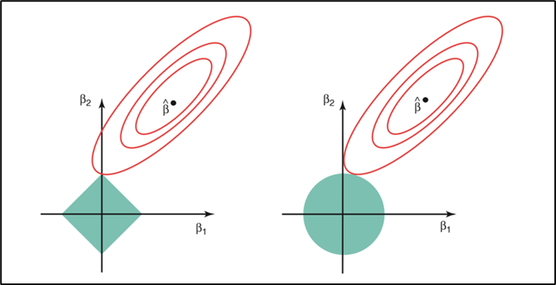
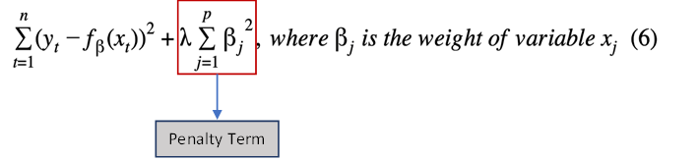
Ridge Regression

Slide 18
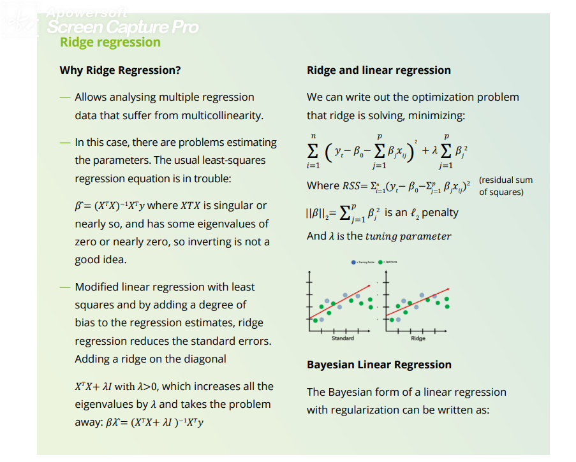
Ridge Regression

Slide 19
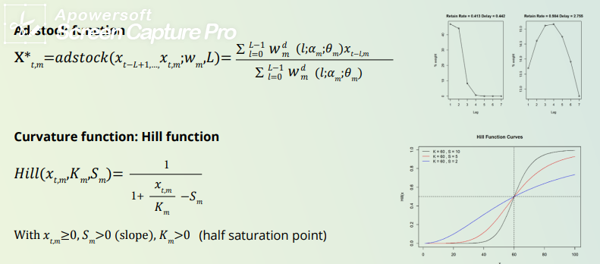
Ad Stock Transformation

